Slide 1
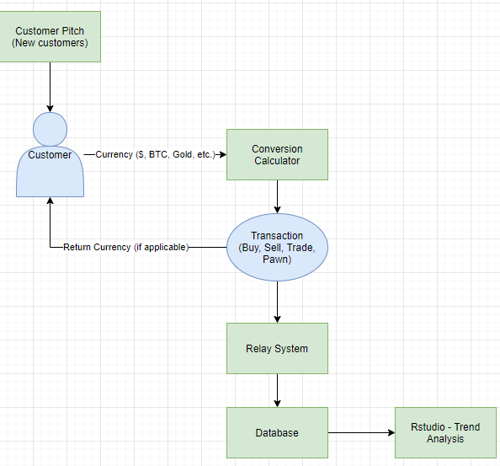
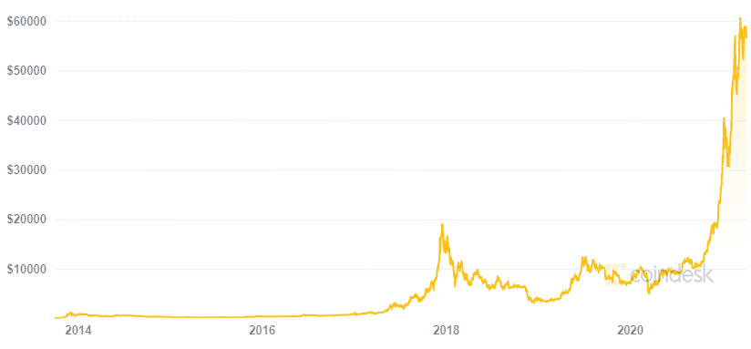
KP PAWN
Durango, Ignacio, Cortez
###-###-####
Addresses
Cryptocurrency Bank and Trader
Kyle Kirkpatrick
Crypto as an Asset
Cryptocurrency is a completely digital/virtual currency, but is volatile like any other asset
Customers will be able to trade currencies, specifically crypto and precious metals.
Maximize assets
Lesson the chance of losing money when using cryptocurrency
Have a secure physical and virtual inventory for customers to store their product
Research Question
How can customers and the pawn shop both benefit from using cryptocurrency?
Our Service
We give a chance for customers to buy/trade/sell their assets. They can also store their assets in our inventory (physical or virtual)
Future Benefits:
Everything is becoming virtual, so a pawn shop should have the ability to deal with crypto
Customers have a variety of ways to manage their assets
Learn trends and cryptocurrency waves
This diagram represents the overall structure and a simple customer transaction.
Assets
Bitcoin (BTC)
Gold
Silver
Ethereum
Helpful Links
https://coinmarketcap.com/
https://docs.google.com/spreadsheets/d/1KM9aJpepyQPmYVHg75_yisxfH6PZIOs7BMiofGM9dHI/edit#gid=0
Risk and Return

